Slide 1
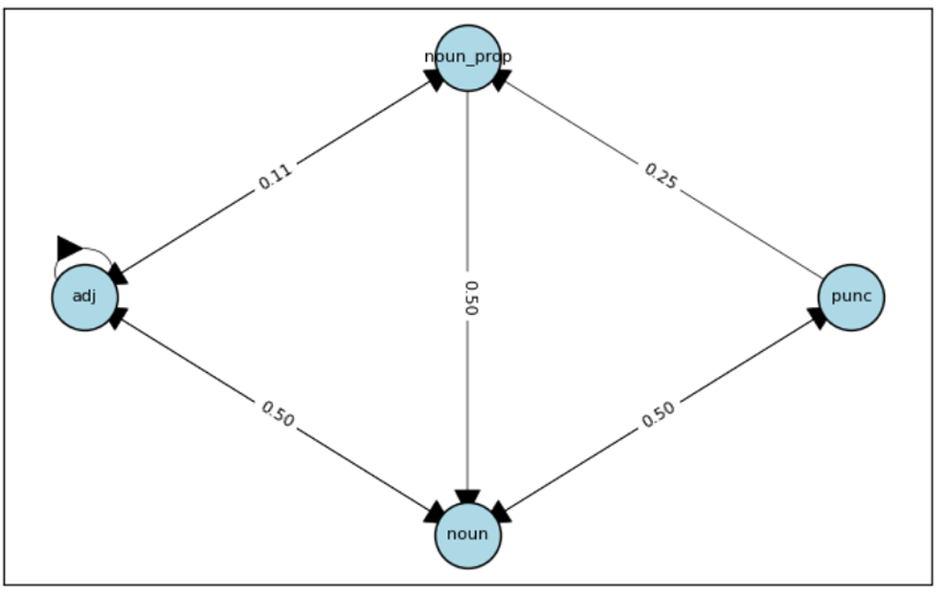
Arabic POS NetworkX

Slide 2
Building a Arabic POS Tagging Pipeline with Network Graphs
Data Preprocessing
Prepare the data for processing.
Optimization
Optimize the time for processing each word in the article.
Techniques
Use any suitable techniques to solve the problem.
Deep Learning (Optional)
Compare different deep learning methods and identify the best one.

Slide 3
Approaches
Rule-based POS tagging(lexicon,context rules(ال+اسم=صفة))
Stochastic (Probabilistic) tagging
Deep learning models.

Slide 4
POS Tagging using Hidden Markov Models (HMM)
A Hidden Markov Model (HMM) is a statistical model that represents systems with hidden states. An HMM consists of:
States: These represent the hidden states of the model. In the context of POS tagging, these are the POS tags themselves (e.g., noun, verb, adjective).
Observations: These are the observed data, which in the case of POS tagging are the words in the sentence.
Transition Probabilities: The probability of transitioning from one state to another.
Emission Probabilities: The probability of a state emitting a particular observation.
Initial Probabilities: The probabilities of the initial states.

Slide 5
Viterbi algorithm
To find the most likely sequence of POS tags for a given sequence of words, the Viterbi Algorithm is used. This dynamic programming algorithm finds the most probable sequence of hidden states (POS tags) given the observations (words).
Dynamic Programming (DP) Matrix (V): This matrix stores the probabilities of the most likely sequence of tags that end in each state (tag) at each time step.
Backpointer (BP) Matrix (B): This matrix stores the backpointers that record the path taken to achieve the highest probability at each step.

Slide 6
Data Set
I utilized a large corpus of Arabic text article scraped from the Youm7 website. The corpus contains 341 sentences of Arabic text. Additionally, to further test our pipeline, we generated 5 new sentences using ChatGPT, based on the content of these article.
Total Articles: One article(contains 341 Arabic sentences) .
Total Sentences: 341 sentences + 5 sentences for testing pipeline.
Total Tags:341 list of tags for each sentence (created using Camel Tool Pos Tagger).

Slide 7
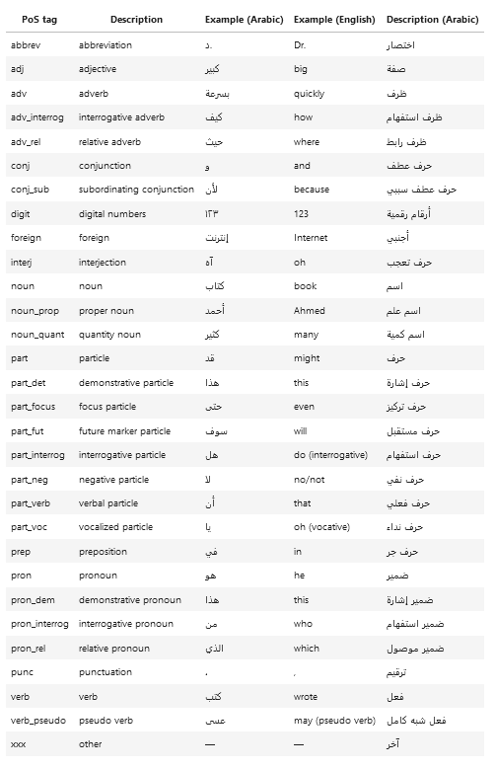
CAMEL TOOLS POS TAGS

Slide 8
Preprocessing(Cleaning Articles)
Remove Tashkeel (Diacritics): Stripping diacritical marks to simplify the text.
Normalize Alef: Standardizing different forms of the letter Alef.
Normalize Hamza: Unifying the representation of Hamza.
Normalize Ya: Standardizing different forms of the letter Ya.
Normalize Ta Marbuta: Converting Ta Marbuta to its standard form.
Remove Emojis: Eliminating any emojis present in the text.

Slide 9
How HMM works(Initialization)
Define the number of tags (num_tags) and words (num_words).
Create the following matrices and vectors initialized to zero:
A Matrix (num_tags x num_tags): Transition count matrix.
B Matrix (num_tags x num_words): Emission count matrix.
π Vector (num_tags): Initial probabilities vector.
Define dictionaries to map tags and words to their indices:
tag2idx: Maps each tag to a unique index.
word2idx: Maps each word to a unique index.

Slide 10
How HMM works(Populate Matrices)
For each sentence in the corpus:
Extract the list of (word, tag) pairs.
Process Each Word-Tag Pair:
If the word is the first in the sentence:
Increment the initial probability count for the tag.
If the word is not the first in the sentence:
Update the transition count from the previous tag to the current tag.
Update the emission count for the current tag and word.

Slide 11
How HMM works(Normalize Matrices)
Normalize the A(Transition Probabilities) Matrix:
Convert transition counts to probabilities by dividing each row by its sum.
Normalize the B(Emission Probabilities) Matrix:
Convert emission counts to probabilities by dividing each row by its sum.
3. Normalize the π(Initial Probabilities) Matrix:
Convert counts to probabilities by dividing each row by its sum.

Slide 12
Example
"التكنولوجيا الحديثة مفيدة جداً. الأجهزة الجديدة مذهلة للغاية. البرامج التعليمية رائعة جداً. الإنترنت سريع جداً ومفيد للغاية. الهواتف الذكية مفيدة جداً."
Tags Founds:
Noun.
Adj.
Noun_prop.
punc.

Slide 13
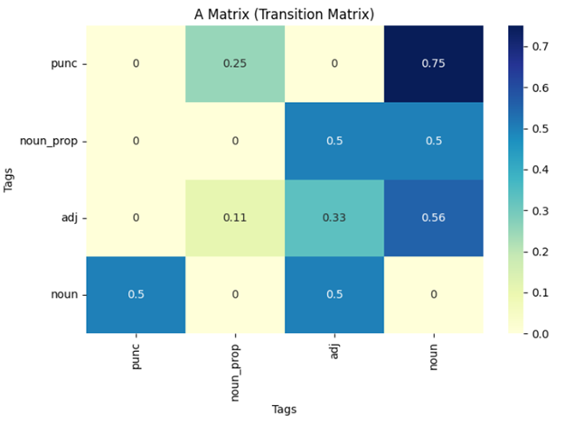

Slide 14
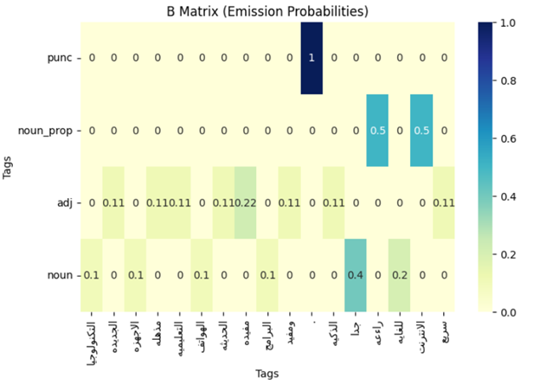

Slide 15
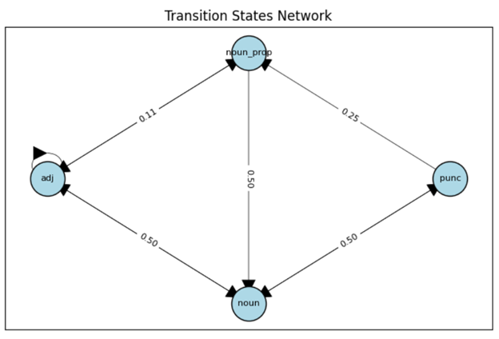

Slide 16
How Viterbi Algorithm Works(Initialization)
Create a DP matrix (dp) and a BP matrix (bp).
Initialize the first column of dp with the initial probabilities multiplied by the emission probabilities of the first observation.

Slide 17
How Viterbi Algorithm Works(Recursion)
For each time step t from 1 to T−1:
For each state s:
Update dp[s, t] with the maximum probability of reaching state s at time t multiplied by the emission probability of the current observation.
Record the state that gave the maximum probability in bp[s, t].

Slide 18
How Viterbi Algorithm Works(Termination)
Identify the state with the highest probability in the last column of dp.
Backtrack through bp to find the most likely sequence of states (POS tags).

Slide 19
Why we use Viterbi Algorithm ??
Computational Cost:
Naive Approach:
Number of possible sequences: S^{T}
For example:4⁶=4096 sequences
Viterbi Algorithm:
Computational cost: O(S²⋅T)
For example: 4²⋅6=96 operations

Slide 20
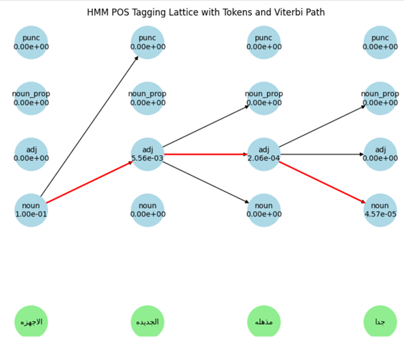

Slide 21
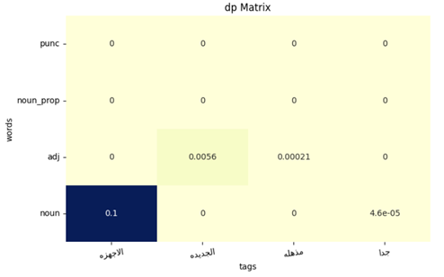

Slide 22
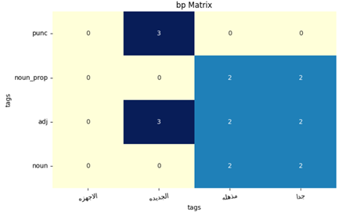

Slide 23
POS Tagging using Deep Learning models
Bi-LSTM (Bidirectional LSTM)
Description: Processes sequences in both forward and backward directions.
Components: Input gate, Forget gate, Output gate, Cell state.
Complexity: Higher due to multiple gate calculations.
Pros: Better at capturing long-term dependencies.
Cons: More computationally intensive, longer training times.
Bi-GRU (Bidirectional GRU)
Description: Processes sequences bidirectionally like Bi-LSTM.
Components: Update gate, Reset gate.
Complexity: Lower with fewer gate calculations.
Pros: More efficient, faster training, less prone to overfitting.
Cons: May not capture long-term dependencies as effectively as LSTM.

Slide 24
Data Set
The data was collected for the purpose of sentiment analysis in order to produce a score for a given company. The data has 40K+ reviews in Arabic for sentiment analysis each labelled with a rating and its associated company name.
Training Set Size: 30,733 sentences(<=60 tokens).
Validation Set Size: 5,762 sentences(<=60 tokens).
Test Set Size: 1,922 sentences(<=60 tokens).

Slide 25
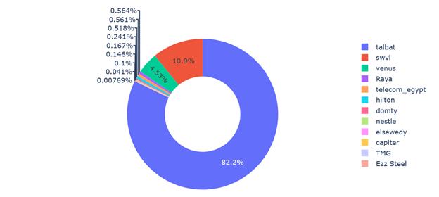
Companies Reviews counts in Data sets

Slide 26
Data Preprocessing(Cleaning)
Data Cleaning: Removed 1,042 duplicated reviews and checked for null reviews (none found).
Token Limit: Removed samples with more than 60 tokens, as most examples contained between 2 and 60 tokens.
Distribution: The graph shows the majority of examples fall within the 2 to 60 token range.

Slide 27
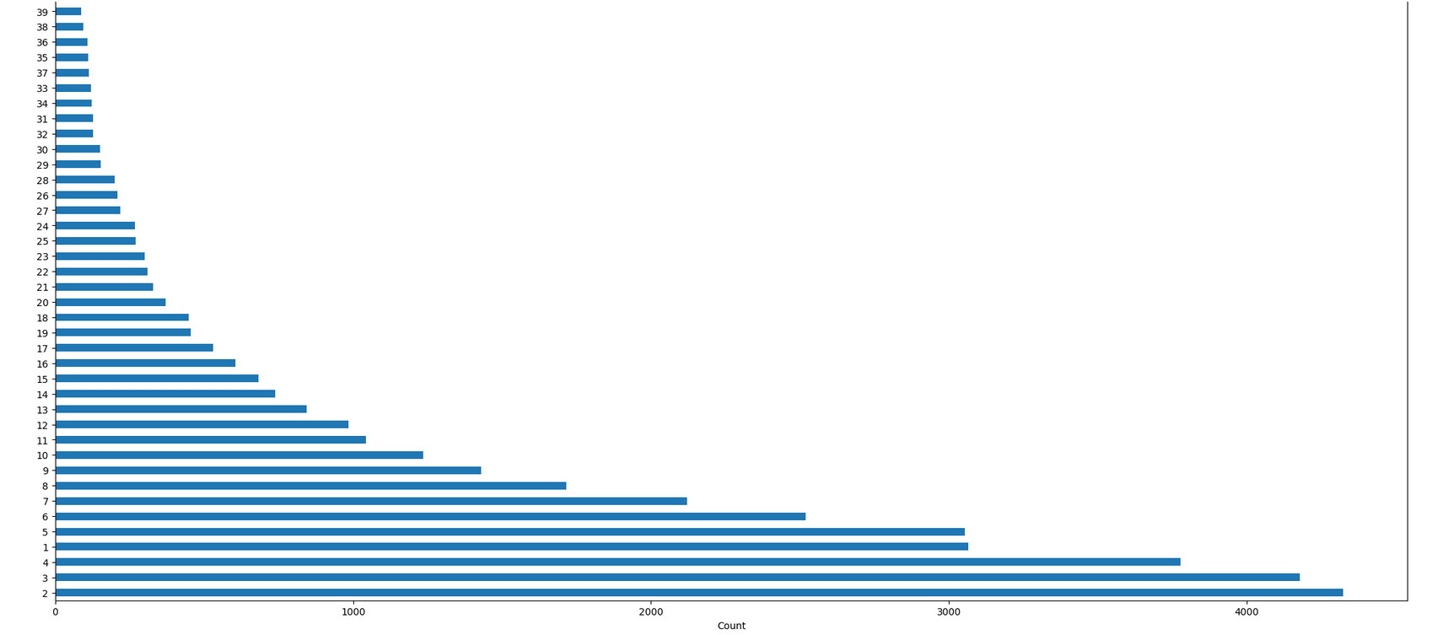

Slide 28
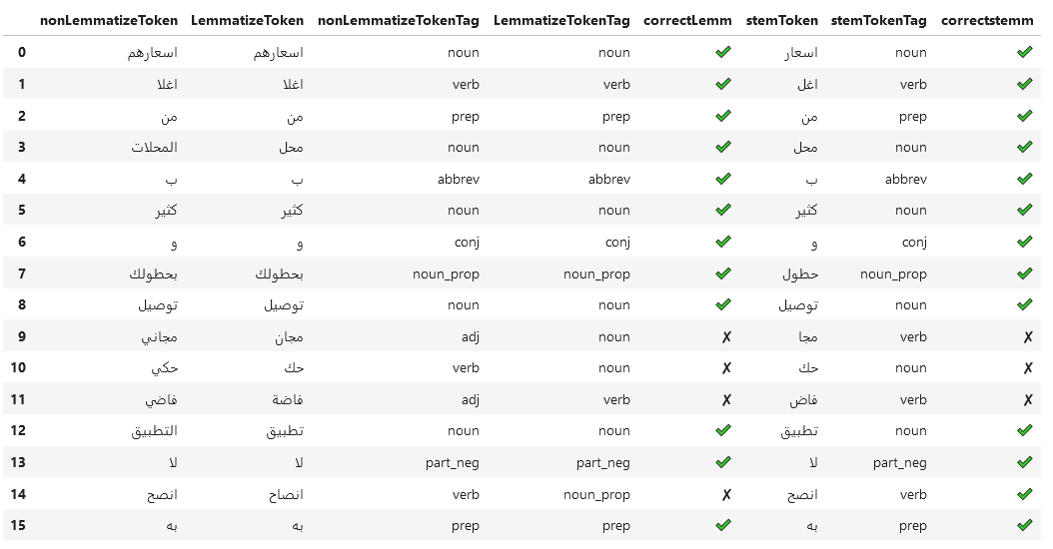
Not Use Lemm or stemm

Slide 29
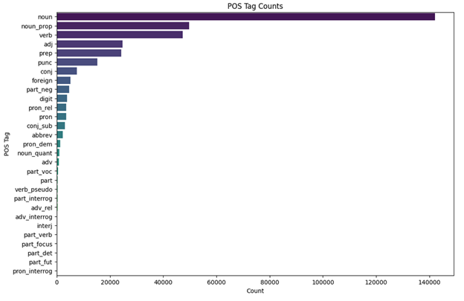
Unbalanced POS Tags

Slide 30
Embedding Model: AraVec For the embeddings
I utilized the AraVec model, specifically the "full_grams_cbow_300_twitter.mdl" variant. AraVec is a pre-trained Arabic word embedding model that captures semantic information from a large corpus of Arabic text. The "full_grams_cbow_300_twitter.mdl" is trained using the Continuous Bag of Words (CBOW) approach with 300 dimensions on Twitter data.

Slide 31
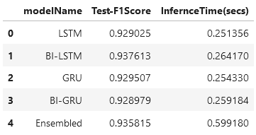
Results

